Slide 1

Welcome to
Year 1 & 2

Slide 2


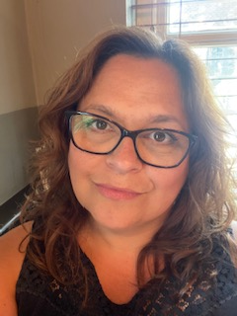

Meet the team
Mrs Rance
Mrs Young, Mrs Sharman and
MRs Bray
Notes:
Hello, my name is Miss Taylor. I have been a teacher for 14 years and have taught different year groups. I'm really excited to be teaching your children, we've spent some time this week getting to know each other and this will continue next week (and over the year!)
This is Miss.... who the children already know.

Slide 3
Start and end of the day
Soft start from 8:35-8:45
Registers are at 8:45. Anyone arriving after this time will be marked as late
Drop children at the outside door – Please allow them to walk in alone.
Collection at 3:15
Please collect from the outside door.

Slide 4
Transition
We understand that transition can be hard especially for some. We are aiming to make it a gradual transition for all by including CIL time – this is their time for independent learning in the areas set out around the indoor and outdoor space. We will enhance this with items linked to the learning from that week in order that they can demonstrate their learning to us in this gentle and fun way. Therefore, we are aiming to keep carpet time and sitting at tables a little less than is usually expected at Year 1 and 2 level and to build in more play-based learning for all the children in this mixed class.

Slide 5
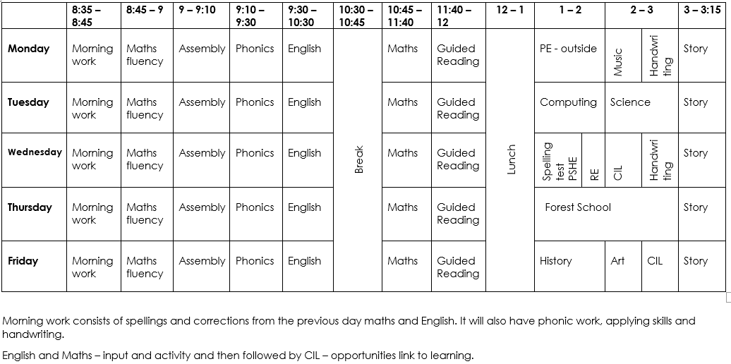
tIMETABLE
Add in a screenshot of your autumn timetable
Notes:
This is our timetable for the year. I have also printed this out and it is in the children's reading record books – I think it's nice for children to know what's coming up. Any anticipated changes I will always tell the children in advance.
Tuesday mornings Mr Trogden will be teaching the children with Miss Hall as a support.

Slide 6
Uniform
Please ensure everything has a name on it.
Blue school jumper
Long hair must be tied up
No jewellery – stud earrings are fine.
No nail varnish please
No (re)dying of hair

Slide 7
p.e
PE
  Trainers (worn all day) and change of socks
  Blue PE t-shirt and jumper (in the cold)
  Dark (preferable black) short or tracksuit bottoms (in the cold)
  Our PE days are Monday.
  Monday will be outside, so jumpers and joggers if it is cold.
  Forest School takes place of our second PE lesson, and this is on a Thursday – children come into school in weather appropriate clothes.

Slide 8
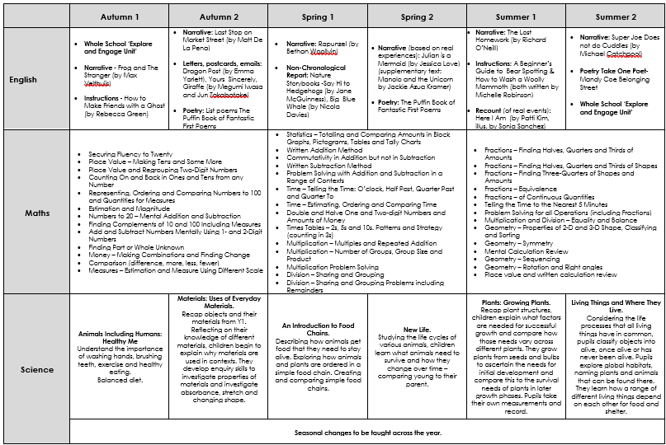
Curriculum MAP
Add in a screenshot of your year group curriculum map
In the meeting talk about what will be covered in the Autumn term

Slide 9
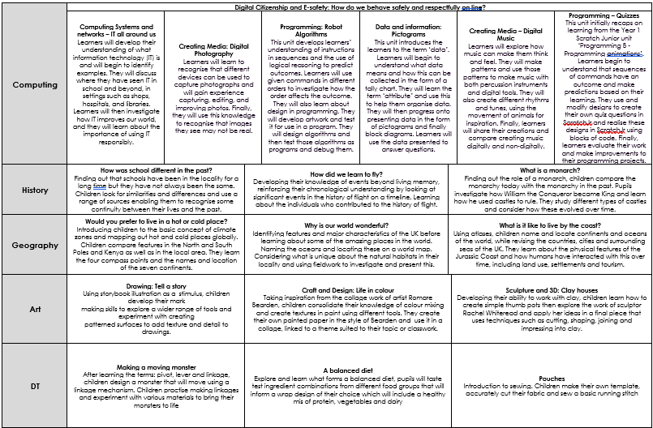
Curriculum MAP
Add in a screenshot of your year group curriculum map
In the meeting talk about what will be covered in the Autumn term

Slide 10
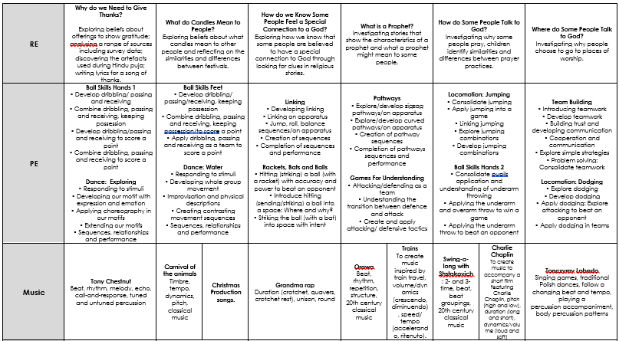
Curriculum MAP
Add in a screenshot of your year group curriculum map
In the meeting talk about what will be covered in the Autumn term

Slide 11

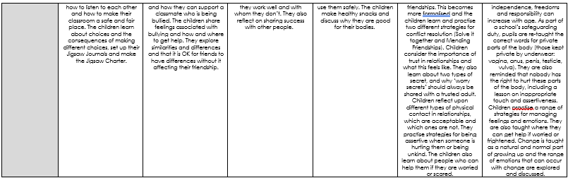
Curriculum MAP
Add in a screenshot of your year group curriculum map
In the meeting talk about what will be covered in the Autumn term

Slide 12
phonics
Phonics will be taught separately as Year 1 and Year 2.
All TAs have been trained to deliver phonics and phonic interventions, so all children are in good hands. We will mix it up so that we all teach both groups.
Year 2 will have some sounds and will also learn spelling patterns and some grammar too.
A parent information sheet will go home on a Friday with the sound/spelling pattern we have learnt that week and there will often be an activity for your child to do at home. This is optional and does not need to come back to school for marking, however, I strongly recommend completing as it will help your child to consolidate their learning.

Slide 13

Home learning
In Year 1 & 2 our homework is reading every day, spellings and maths. We would expect the children to practise their spellings at least 5 times, before their test. Maths is one worksheet to be done weekly.
Maths and spellings will be sent out on a Friday and need to be handed in the following Wednesday. They will be marked by class staff.
Reading is vital. If a child struggles to read, then they struggle with all aspects of the curriculum. It is the gateway to everything.
We will change reading books on a Monday and a Thursday, providing the book has been read three times.

Slide 14
BEHAVIOUR
At Westfield we acknowledge that positive experiences create positive feelings, and that in turn, positive feelings create positive behaviour. Staff will model positive relationships and interactions, use positive phrasing with the children and spend time with children to support them in making positive behaviour choices – that result in pro-social behaviour - where required.
Pro-social behaviours are any actions which benefit the individual and others around them.
• Giving meaningful and specific verbal praise and positive feedback
• Allocating roles and responsibilities
• Communicating a child’s pro-social behaviours with parents and/carers as appropriate
• Using stickers, certificates, merits, value of the week, marbles etc/
• Building in ‘motivators’ following the engagement of ‘adult directed activities’
• Awarding Teacher and Head Teacher stickers/awards
• Acknowledging pupils in Friday Celebration assembly
• Recognising care and respect of the learning environment
• Modelling and teaching children to self-regulate using resources that help pupils to stay calm and to understand their own emotions

Slide 15
BEHAVIOUR
Class rewards – each class has its own reward system for whole class rewards. We will use stickers, verbal praise, value certificates, marbles to work towards a whole class treat and other notes/certificates.
Merits are received for positive work. Headteachers certificates are then received on receipt of 10 merits
Values certificates are given out each week to a child in each class who has demonstrated the value that week
Maths wizards certificates are given when child achieve the next level – Year 2 onwards
Reading certificates are received for reading 50, 100, 150 and 20o times
Please share any outside achievements with us, we love to hear about them and celebrate what the children have achieved.
Celebration assembly on Fridays at 9am – all parents are welcome

Slide 16
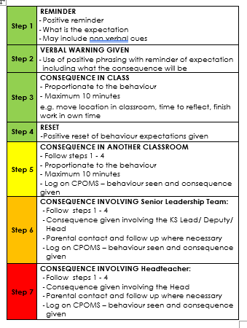

BEHAVIOUR
The Behaviour policy was re-written in January 2024. Please ensure you have read it and are clear on our procedures within school. This includes our behaviour steps and level letters.

Slide 17
Mobile phones
We are supporting the ‘Smartphone free childhood’ campaign. As such we actively encourage you not to purchase a smart phone for your child.
As a town the schools are working together to have a collective approach on this moving forward.
Please read more about it at https://smartphonefreechildhood.co.uk/
Mobile phones are allowed in Y5 and Y6. They are to be handed in as soon as they enter school and will be returned at the end of the day
If your child does have a mobile phone, please carefully monitor their interaction on it. The social media issues which occur happen at home continue into school and significantly impact mental health and learning. We need to work together to support our children.

Slide 18
Helping in school
Parent volunteers are very welcome in school, either regularly or ad-hoc. A DBS check is required – forms from the office.
Reading with children – we really appreciate this.
WISPA are always wanting and needing parental engagement – please get involved! The funds they raise help to provide a range of wider opportunities for your children as well as resources in school

Slide 19
Reminders
Most children benefit from having a piece of fruit at break time – this is provided by school but if you would prefer you can send your own piece in for them.
No sweets in lunchboxes
Please let us know if pick up arrangements change
Let the office know of any regular pick-up changes
Please ensure PE kits are in school each day – this allows us to make the most of additional opportunities.
Encourage your children to talk to the adults in school – we cannot help if we do not know. Any problems that arise are better dealt with there and then rather than at a later time
Stationery is provided so please leave all personal items at home
Named water bottle

Slide 20
Communication
Everything we do is because we believe it will benefit the children. If you think there is something we should know that will help us help your child, please do tell us!
Please catch us at the start or the end of the day for any quick messages. For any longer discussions, please arrange a meeting.

Slide 21


