Slide 1

Welcome to
Year 3

Slide 2
Meet the team
Class Teachers
Mrs Edwards
Monday- wednesday
Mrs lamb
Thursday-Friday
Teaching assistants
Miss May
Miss Jordan
Mrs Waheed
Notes:
Hello, my name is Miss Taylor. I have been a teacher for 14 years and have taught different year groups. I'm really excited to be teaching your children, we've spent some time this week getting to know each other and this will continue next week (and over the year!)
This is Miss.... who the children already know.

Slide 3
Start and end of the day
Soft start from 8:35-8:45am
Registers are at 8:45am. Anyone arriving after this time will be marked as late
Drop children at the outside door – Please allow them to walk in alone.
Collection at 3:15pm
Please collect from the outdoor classroom and wait for your child name to be called.

Slide 4
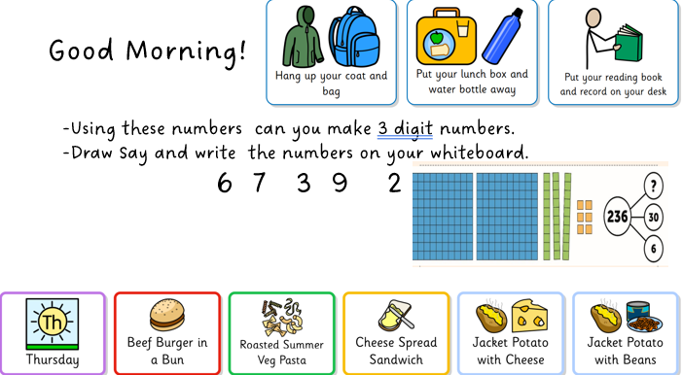
Morning routine

Slide 5
Uniform
Please ensure everything has a name on it.
Blue school jumper
Long hair must be tied up
No jewellery – stud earrings are fine.
No nail varnish please
No (re)dying of hair

Slide 6
p.e
PE Wednesday and Thursdays
  Trainers (worn all day) and change of socks
  Blue PE t-shirt and jumper (in the cold)
  Dark (preferable black) short or tracksuit bottoms (in the cold)
Forest school
Wellington boots
Waterproof clothing

Slide 7
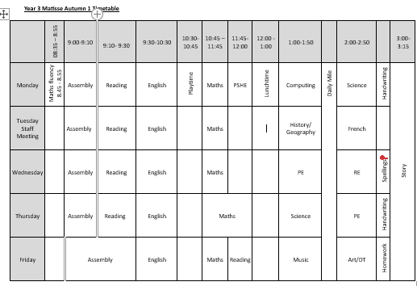
Curriculum MAP

Slide 8
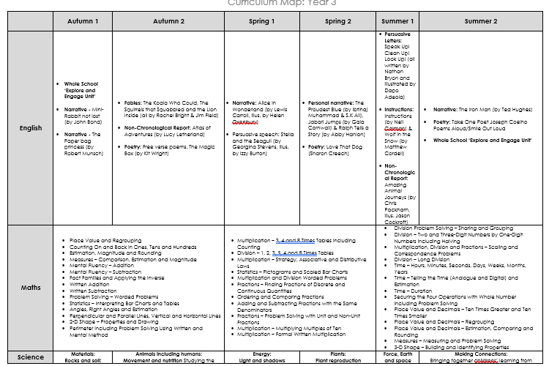
Curriculum MAP
Add in a screenshot of your year group curriculum map
In the meeting talk about what will be covered in the Autumn term

Slide 9
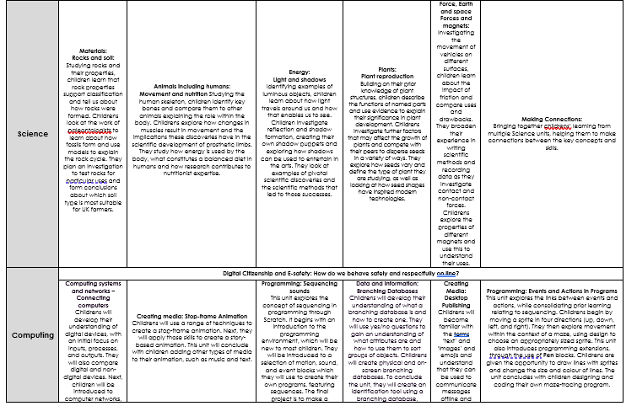
Curriculum MAP

Slide 10
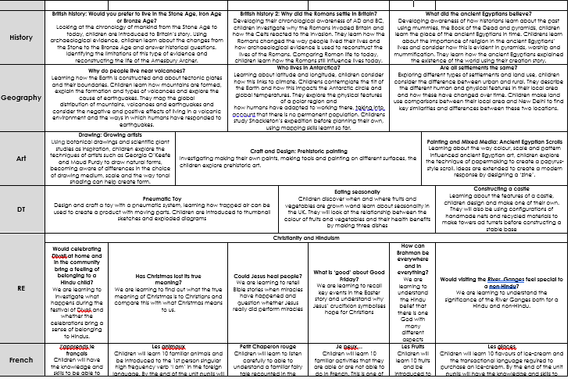
Curriculum MAP
Add in a screenshot of your year group curriculum map
In the meeting talk about what will be covered in the Autumn term

Slide 11
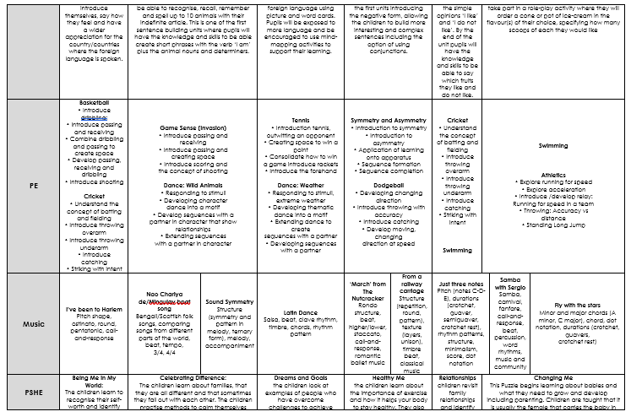
Curriculum MAP
Add in a screenshot of your year group curriculum map
In the meeting talk about what will be covered in the Autumn term

Slide 12

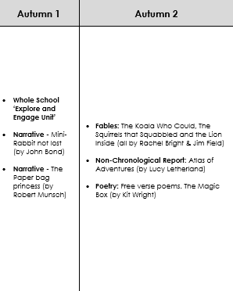


Curriculum MAP

Slide 13
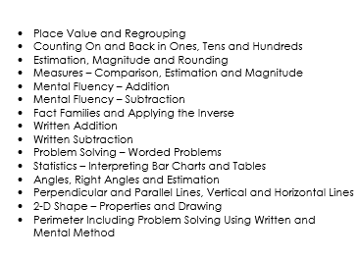

Curriculum MAP

Slide 14
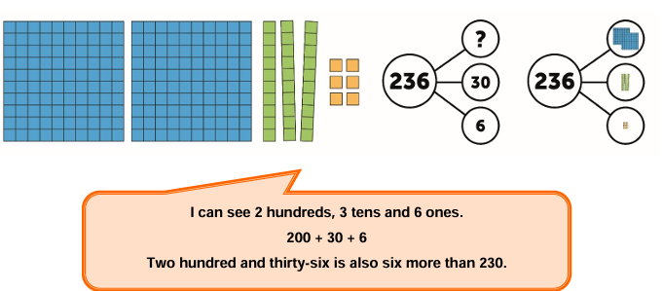
Place value
https://polypad.amplify.com/

Slide 15

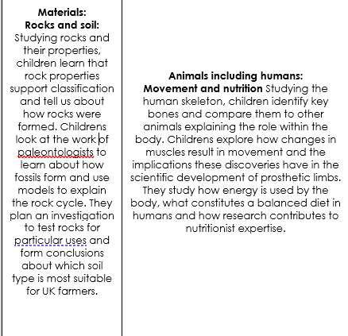
Curriculum MAP

Slide 16

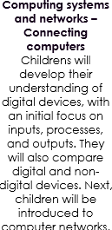
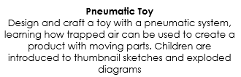


Curriculum MAP

Slide 17

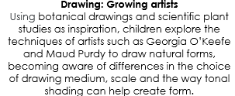


Curriculum MAP
What makes us human?
Interpreting and using art to express beliefs about spirituality, inner self and the soul.

Slide 18

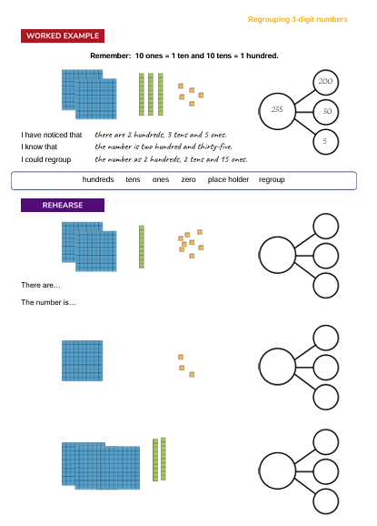
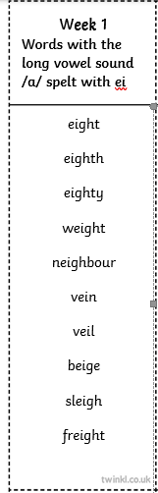

Home learning

Slide 19
READING
Children will continue to have their books checked and changed on a Monday and Thursday, as they did in Year 2. However, as they move on to longer books, it may not always be appropriate to change them as frequently, and they may need to keep a book for longer before moving on.
If they have read their book a couple of times, they can go and ask an adult to change it (even if it isn’t a Monday or Thursday). This will help to start fostering their independence with reading.

Slide 20
BEHAVIOUR
At Westfield we acknowledge that positive experiences create positive feelings, and that in turn, positive feelings create positive behaviour. Staff will model positive relationships and interactions, use positive phrasing with the children and spend time with children to support them in making positive behaviour choices – that result in pro-social behaviour - where required.
Pro-social behaviours are any actions which benefit the individual and others around them.
• Giving meaningful and specific verbal praise and positive feedback
• Allocating roles and responsibilities
• Communicating a child’s pro-social behaviours with parents and/carers as appropriate
• Using stickers, certificates, merits, value of the week, marbles etc/
• Building in ‘motivators’ following the engagement of ‘adult directed activities’
• Awarding Teacher and Head Teacher stickers/awards
• Acknowledging pupils in Friday Celebration assembly
• Recognising care and respect of the learning environment
• Modelling and teaching children to self-regulate using resources that help pupils to stay calm and to understand their own emotions

Slide 21
BEHAVIOUR
Reading certificates are received for reading 50, 100, 150 and 20o times
Please share any outside achievements with us, we love to hear about them and celebrate what the children have achieved.
Celebration assembly on Fridays at 9am – all parents are welcome.

Slide 22
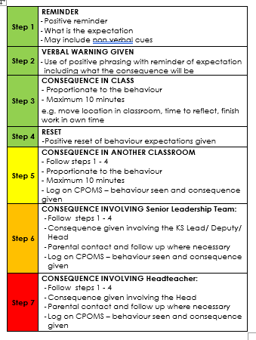
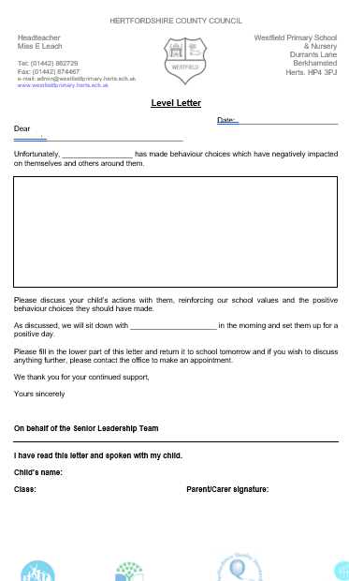
BEHAVIOUR
The Behaviour policy was re-written in January. Please ensure you have read it and are clear on our procedures within school. This includes our behaviour steps and level letters.

Slide 23
Mobile phones
We are supporting the ‘Smartphone free childhood’ campaign. As such we actively encourage you not to purchase a smart phone for your child.
As a town the schools are working together to have a collective approach on this moving forward.
Please read more about it at https://smartphonefreechildhood.co.uk/
Mobile phones are allowed in Y5 and Y6. They are to be handed in as soon as they enter school and will be returned at the end of the day
If your child does have a mobile phone, please carefully monitor their interaction on it. The social media issues which occur happen at home continue into school and significantly impact mental health and learning. We need to work together to support our children.

Slide 24
Helping in school
Parent volunteers are very welcome in school, either regularly or ad-hoc. A DBS check is required – forms from the office.
Reading with children – we really appreciate.
WISPA are always wanting and needing parental engagement – please get involved! The funds they raise help to provide a range of wider opportunities for your children as well as resources in school

Slide 25
Reminders
Most children benefit from having a piece of fruit at break time
No sweets, chocolate or nuts in lunchboxes
Please let us know if pick up arrangements change
Let the office know of any regular pick up changes
Encourage your children to talk to the adults in school – we cannot help if we do not know. Any problems that arise are better dealt with there and then rather than at a later time
Stationery is provided so please leave all personal items at home
Named water bottle

Slide 26
Communication
Everything we do is because we believe it will benefit the children. If you think there is something we should know that will help us help your child, please do tell us!
Please catch us at the start or the end of the day for any quick messages. For any longer discussions, please arrange a meeting.

Slide 27
reminders
Communication
The number one priority for our Year 3 team is that your child is happy and settled and has an enjoyable year.
If you have any questions or concerns about your child’s education or well-being, then please communicate your worries with us.
We are always keen to help!

Slide 28


