Slide 1

Welcome to
Year 4

Slide 2
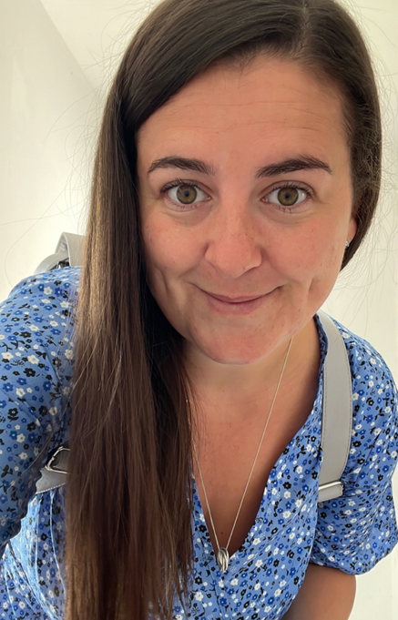
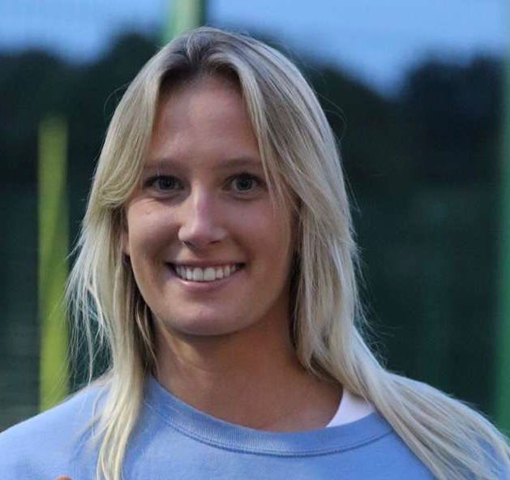
Meet the team
Class Teacher – Mrs Freemantle
TA – Miss Lane

Slide 3
Start and end of the day
Soft start from 8:35-8:45
Please be prompt as we will be doing starter activities and maths fluency first thing which is very important to help the children consolidate their learning.
Registers are at 8:45. Anyone arriving after this time will be marked as late and need to go to the office if my external door is locked.
Drop children at the outside door – Please allow them to walk in alone and do not enter the classroom.
Collection at 3:15
Please collect from the bottom playground, We will line the children up and dismiss them one at a time when we see their adult.

Slide 4
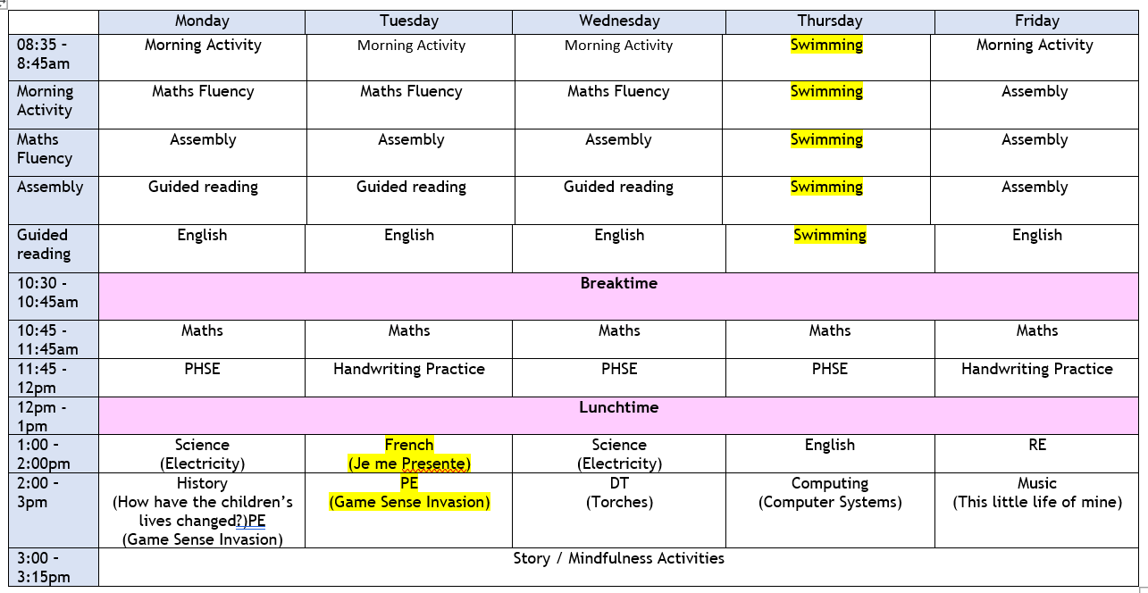
tIMETABLE

Slide 5
Uniform
Please ensure everything has your child’s name on it even if it is a preloved item.
Blue school jumper only, no other jumpers or hoodies.
Long hair must be tied up.
No jewellery – stud earrings are fine.
No nail varnish please.
No (re)dying of hair.

Slide 6
p.e
PE - TUESDAY
  Trainers (worn all day) and change of socks
  Blue PE t-shirt and jumper (in the cold)
  Dark (preferable black) short or tracksuit bottoms (in the cold)
Swimming - THURSDAY
  Meet at the sports centre by 8.45am latest
  Swim stuff worn under uniform for a quick change.
  Parents don’t stay
  Walked back by school staff

Slide 7
Reading
Reading
Reading is so important in year 4. For reading progression to happen, fluency to develop and translation across to their English work ideally they need to read a minimum of 5 times a week to an adult for 10 minutes at a time.
I would really encourage you to try and do this to best support your child academically and with their reading aloud confidence. Please sign in their reading record and let me know if they are struggling with anything.
I check reading records myself every Monday and Friday.
Miss Lane and I will also pull individual readers where possible.
Reading books will be changed only when we have seen they have read that book to an adult on more than two occasions.
I encourage children to read lots of types of books but it is very important that they read their school reading book.

Slide 8
Timestable mtc
In year 4 the children will have a timestable government test in the early summer term.
Times tables underpin multiplication, division, fractions, ratios, and even algebra later on.
Without fluency, children struggle with multi-step problems, as they spend too long working out basic facts.
I will be pushing the children to practice their timestables, they have to answer the questions in less than 6 seconds. The best website to get an insight into how your child is improving is : https://urbrainy.com/mtc
I have already logged how many out of 25 your child can do and which timestables will be their focus for the next couple of weeks.
I will regularly re assess and adapt their focus accordingly.
My overall aim with your support at home is to build your child’s confidence in maths and with their number fluency.

Slide 9
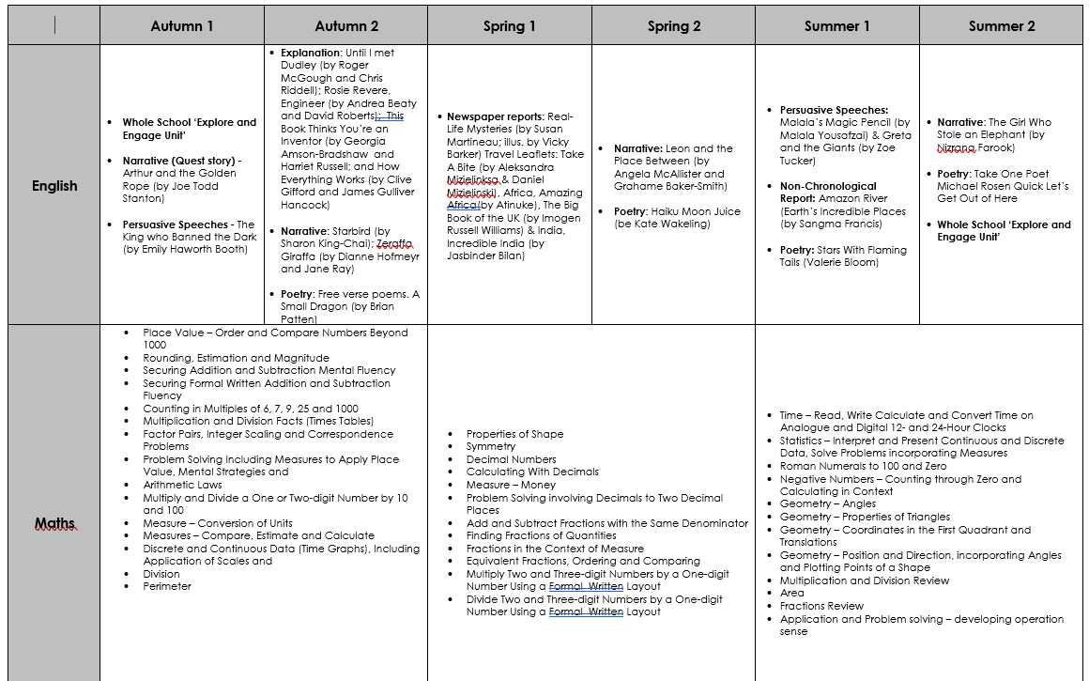
Curriculum MAP

Slide 10
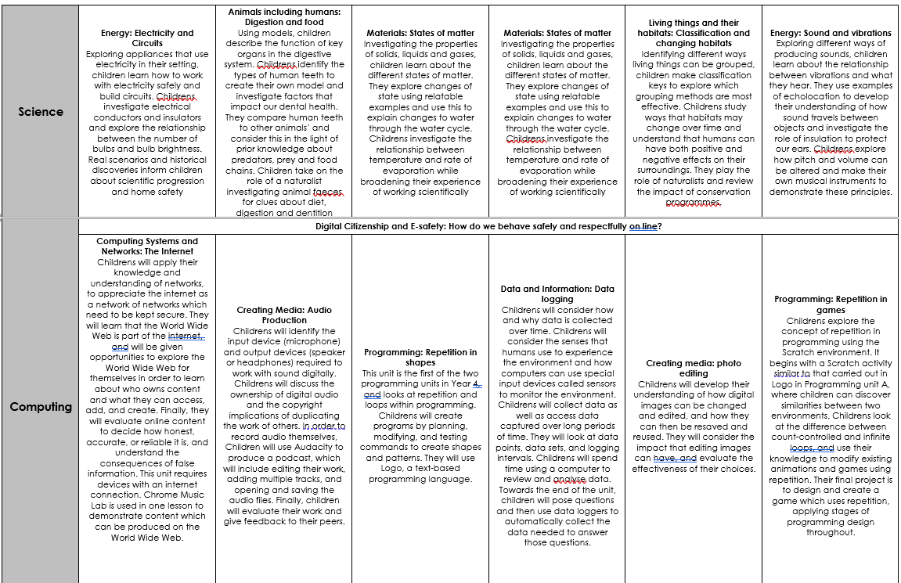
Curriculum MAP

Slide 11
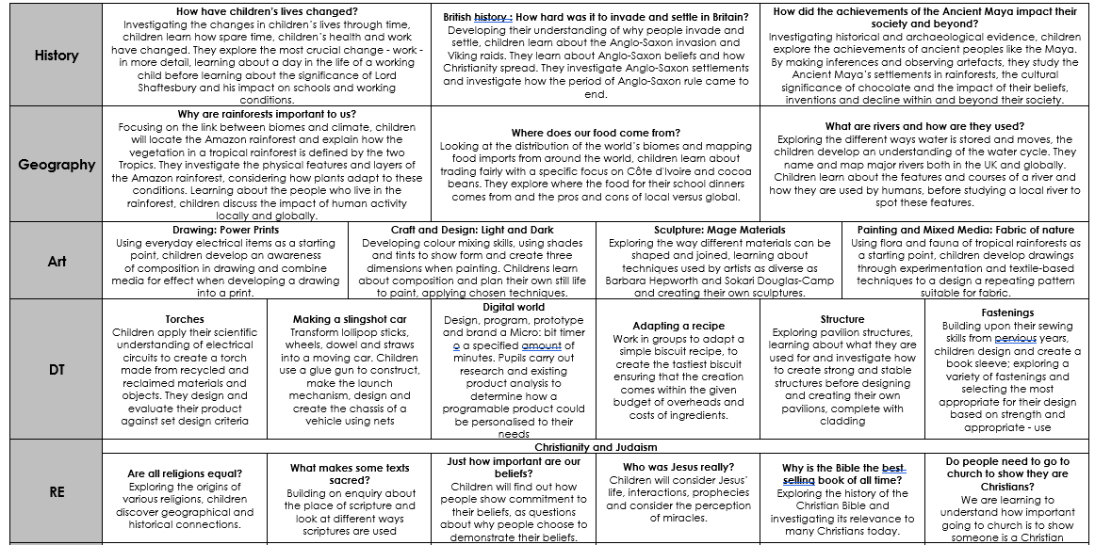
Curriculum MAP

Slide 12
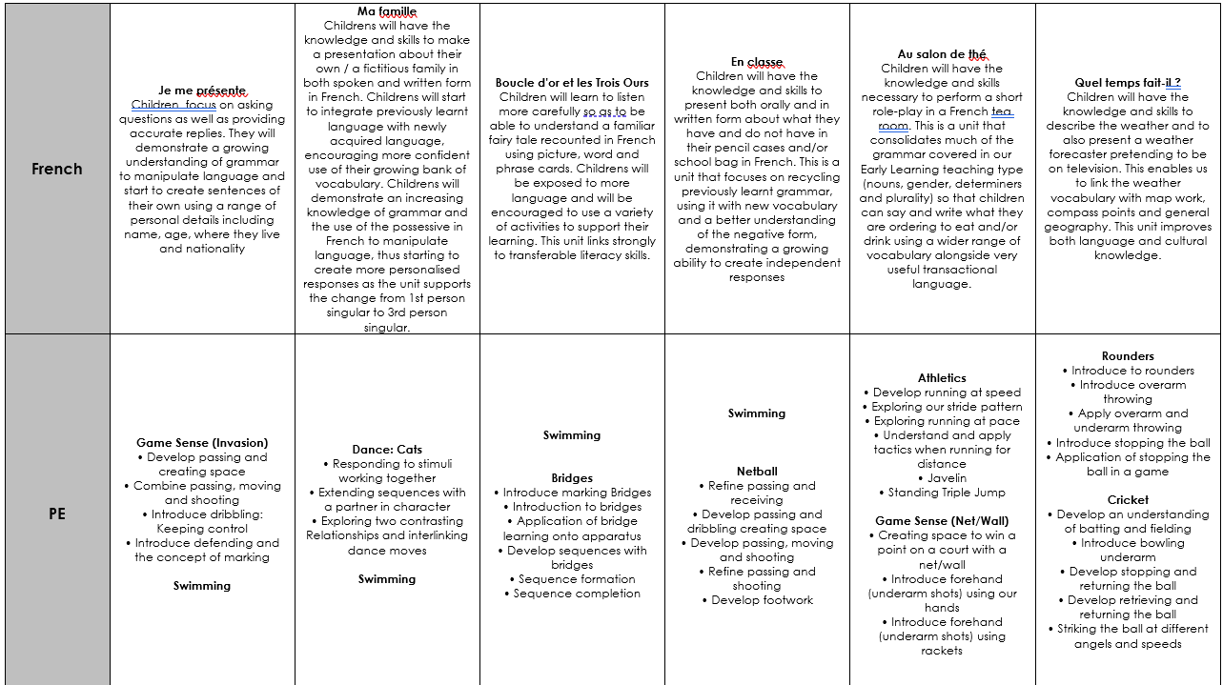
Curriculum MAP

Slide 13
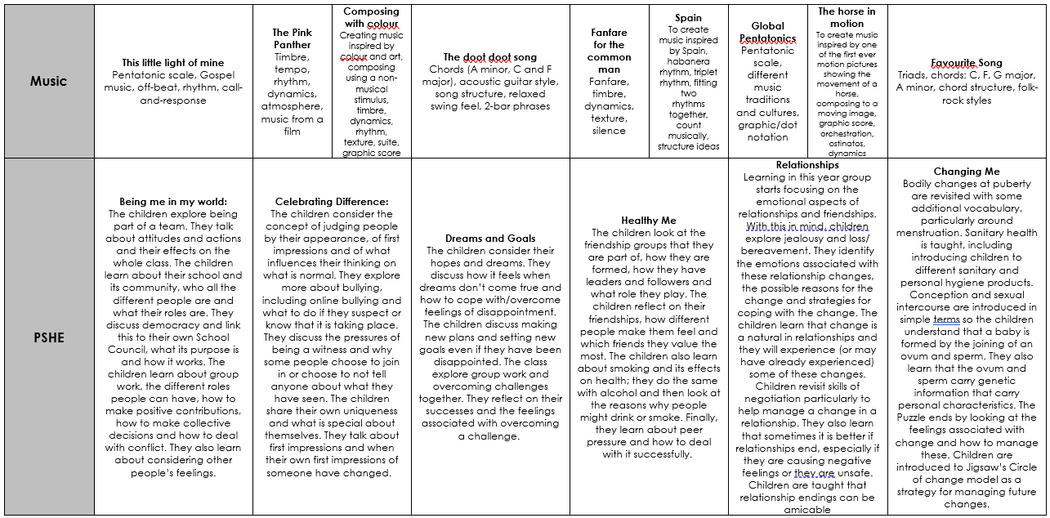
Curriculum MAP

Slide 14

Home learning
Home learning policy has been re-written following consultation from children, staff and parents.
Home support and education is so important, this year I will be setting homework due the following week on a Friday and due back on a Wednesday.
Daily reading is expected and please can ADULTS ONLY write in the reading records
Multiplication practice flash cards / online games daily.
Spellings
Maths based on that weeks learning
English will be set but not every week and may vary depending on the need
Specific work per child may be sent home if we feel they need a little extra practice.

Slide 15
BEHAVIOUR
At Westfield we acknowledge that positive experiences create positive feelings, and that in turn, positive feelings create positive behaviour. Staff will model positive relationships and interactions, use positive phrasing with the children and spend time with children to support them in making positive behaviour choices – that result in pro-social behaviour - where required.
Pro-social behaviours are any actions which benefit the individual and others around them.
• Giving meaningful and specific verbal praise and positive feedback
• Allocating roles and responsibilities
• Communicating a child’s pro-social behaviours with parents and/carers as appropriate
• Using stickers, certificates, merits, value of the week, marbles etc/
• Building in ‘motivators’ following the engagement of ‘adult directed activities’
• Awarding Teacher and Head Teacher stickers/awards
• Acknowledging pupils in Friday Celebration assembly
• Recognising care and respect of the learning environment
• Modelling and teaching children to self-regulate using resources that help pupils to stay calm and to understand their own emotions

Slide 16
BEHAVIOUR
Class rewards – each class has its own reward system for whole class rewards In year 4 the children are working towards earning their own desk pets.
Merits are received for positive work. Headteachers certificates are then received on receipt of 10 merits
Values certificates are given out each week to a child in each class who has demonstrated the value that week
Maths wizards certificates are given when child achieve the next level
Please share any outside achievements with us, we love to hear about them and celebrate what the children have achieved.
Celebration assembly on Fridays at 9am – all parents are welcome

Slide 17
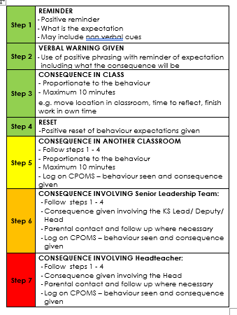
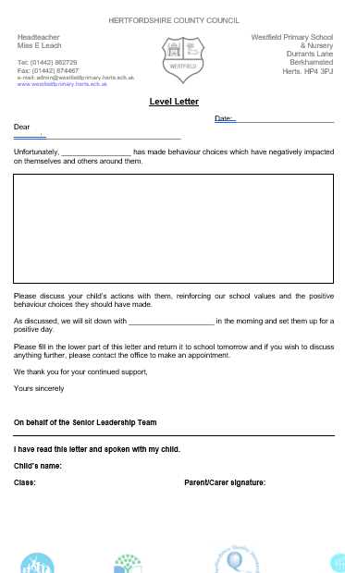
BEHAVIOUR
The Behaviour policy – Please ensure you have read it and are clear on our procedures within school. This includes our behaviour steps and level letters.

Slide 18
Mobile phones
We are supporting the ‘Smartphone free childhood’ campaign. As such we actively encourage you not to purchase a smart phone for your child.
As a town the schools are working together to have a collective approach on this moving forward.
Please read more about it at https://smartphonefreechildhood.co.uk/
Mobile phones are allowed in Y5 and Y6. They are to be handed in as soon as they enter school and will be returned at the end of the day
If your child does have a mobile phone, please carefully monitor their interaction on it. The social media issues which occur happen at home continue into school and significantly impact mental health and learning. We need to work together to support our children.

Slide 19
Helping in school
Parent volunteers are very welcome in school, either regularly or ad-hoc. A DBS check is required – forms from the office.
Reading with children – we really appreciate this in KS2.
Could anyone help with weekly reading to my class?
WISPA are always wanting and needing parental engagement – please get involved! The funds they raise help to provide a range of wider opportunities for your children as well as resources in school

Slide 20
Reminders
Most children benefit from having a piece of fruit at break time
No sweets in lunchboxes
Please let us know if pick up arrangements change
Let the office know of any regular pick up changes
Encourage your children to talk to the adults in school – we cannot help if we do not know. Any problems that arise are better dealt with there and then rather than at a later time
Stationery is provided so please leave all personal items at home
Named water bottle

Slide 21
School Trips
Ragged Museum – 18th November 2025 https://raggedschoolmuseum.org.uk/
Residential – Summer Date to be Confirmed
Pizza Express School Visit to make our own pizza – Summer Date to be Confirmed

Slide 22
Communication
Everything we do is because we believe it will benefit the children. If you think there is something we should know that will help us help your child, please do tell us!
Please catch us at the start or the end of the day for any quick messages. For any longer discussions, please arrange a meeting.

Slide 23


