Slide 1

Welcome to
YeaR FIVE

Slide 2
Meet the team
Teacher: Mrs Crossley works Monday-Wednesday
Teacher: Miss Roe works Thursday and Friday
Teaching assistant: Mrs Hall – every day

Slide 3
Start and end of the day
Arrive between 8:35-8:45am.
Registers are at 8:45am. Anyone arriving after this time will be marked as late.
School ends at 3:15pm.
Children wait outside the Year 5 door leading onto the top playground in the morning and this is where they are dismissed from at the end of the day too.

Slide 4
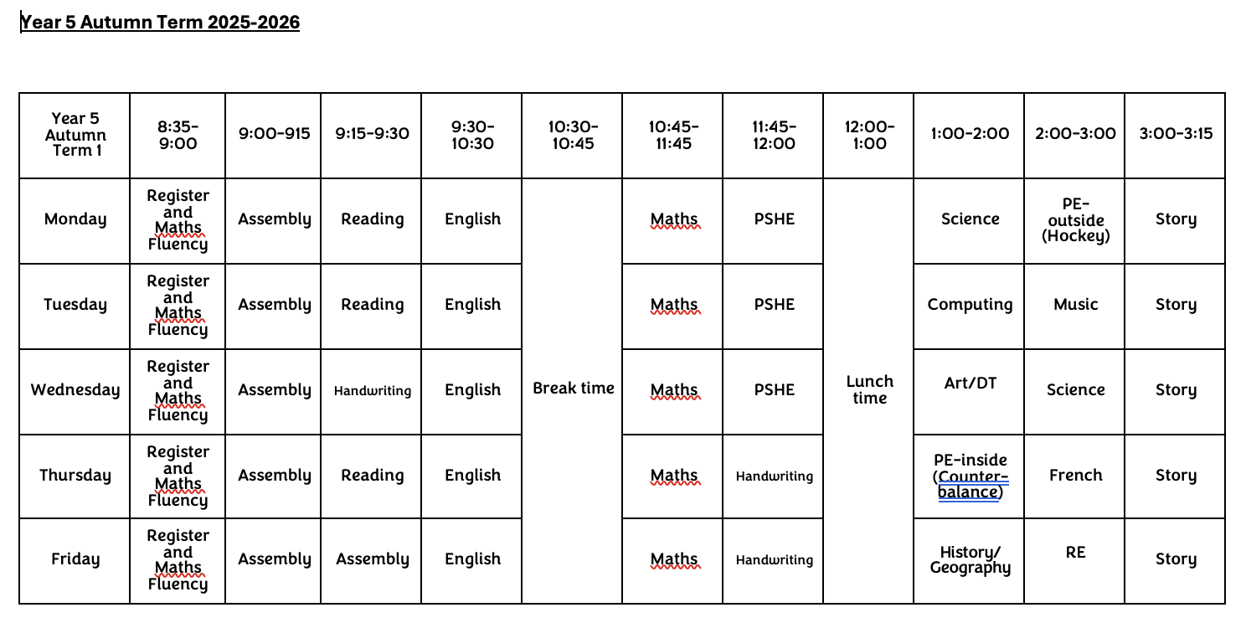
tIMETABLE

Slide 5
Curriculum MAP
English
Non-chronological report: Monsters, beasts and mythical creatures
Narrative: Cloud Tea Monkeys
Non-chronological report: The street beneath our feet
Narrative: The promise
Poetry: Where the poppies now grow
Maths
Place value up to three decimal places and rounding
All four operations
Fractions – ordering, comparing and equivalent
Worded problems and problem solving

Slide 6
Curriculum MAP
Science
Materials: Forces
Materials: Earth and Space
Computing
Systems, networks and searching
Creating media: Video production

Slide 7
Curriculum MAP
History
Vikings – Children learn about the Vikings, the struggle for Britain and the impact they had on local British communities.
Geography
The Alps – Children discover the climate of mountain ranges, why people choose to visit the Alps and identify human and physical fetures.

Slide 8
Curriculum MAP
RE
Why doesn't Christianity always look the same?
Why do people have to stand up for what they believe in?
Art
Painting and mixed media: Portraits
DT
Designing and making a gear and pulley system
French
Pets – what pets they may or may not have
My house – where they live, what rooms they have or do not have

Slide 9
Curriculum MAP
PE
Counter-balance and hockey
Dodgeball and flight
PSHE
Being in my world
Celebrating difference
Music
Sea shanties, beat, rhythm, chords, bass
Gospel music
Songwriting

Slide 10
Reading
At Westfield, we expect children to be reading daily. In Year 5, this should be for at least 10 minutes per day.
Tips and ideas:
Discuss the vocabulary with your child, do they know what the word means?
Do they know words that have a similar meaning?
Do they know words that mean the opposite?
Can they find an adjective/conjunction/noun/verb?
Can they predict what might happen next?
Can they predict how a character might react?
Discuss the story, the order of events, the character's feelings, thoughts, spoken words.
Can your child retell the story in their own words.

Slide 11
Spelling
At Westfield, we follow the Twinkl spelling scheme in KS2. This scheme provides weekly spellings that are sent home on a Friday and the children are tested the following Friday.
We adapt the spellings to better meet the needs of some learners. So, some children will receive different words to practise for their spelling tests, focusing on phonics and certain spelling rules that they need to secure.
Please practise these at home with your child, it is also important that they can use the words in a sentence too.

Slide 12
Uniform
Please ensure everything has a name on it - including a water bottle.
Blue school jumper/cardigan.
White or blue polo shirt with collar and school logo on it.
Grey tailored skirt/trousers/pinafore dress. Blue and white check dress for summer.
Long hair must be tied up.
No jewellery – stud earrings are fine.
No nail varnish please.
No (re)dying of hair.

Slide 13
p.e
PE
  Blue t-shirt with school logo
  Plain navy or black shorts/trousers
  Blue school hoodie
  Trainers (no lights) Please ensure children can tie their laces.
  Please note:
  There should be no branded logo's on any clothes worn to school.
  Hair which is longer than shoulder length needs to be tied up.

Slide 14

BEHAVIOUR
At Westfield we acknowledge that positive experiences create positive feelings, and that in turn, positive feelings create positive behaviour. Staff will model positive relationships and interactions, use positive phrasing with the children and spend time with children to support them in making positive behaviour choices – that result in pro-social behaviour - where required.
Pro-social behaviours are any actions which benefit the individual and others around them.
• Giving meaningful and specific verbal praise and positive feedback
• Allocating roles and responsibilities
• Communicating a child’s pro-social behaviours with parents and/carers as appropriate
• Using stickers, certificates, merits, value of the week, marbles etc/
• Building in ‘motivators’ following the engagement of ‘adult directed activities’
• Awarding Teacher and Head Teacher stickers/awards
• Acknowledging pupils in Friday Celebration assembly
• Recognising care and respect of the learning environment
• Modelling and teaching children to self-regulate using resources that help pupils to stay calm and to understand their own emotions

Slide 15
BEHAVIOUR
Individual rewards – stickers, charms, erasers – each class has its own reward system
Merits are received for positive work. Headteachers certificates are then received on receipt of 10 merits
Values certificates are given out each week to a child in each class who has demonstrated one of the school's values.
Maths wizards certificates are given when a child achieves the next level
Please share any outside achievements with us, we love to hear about them and celebrate what the children have achieved.
Celebration assembly on Fridays at 9am – all parents are welcome

Slide 16
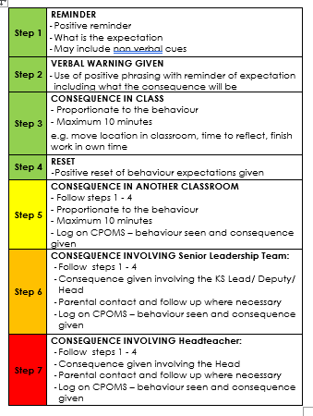
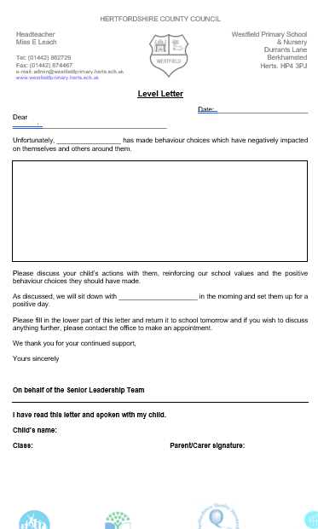
BEHAVIOUR
The Behaviour policy was re-written in January. Please ensure you have read it and are clear on our procedures within school. This includes our behaviour steps and level letters.

Slide 17
Home learning
Home learning policy has been re-written in July 2024 following consultation from children, staff and parents.
Reading – Daily reading at home for at least 10 minutes each day and recording in the reading record (either parent or child). Reading is vital and lost books will be charged for.
Spellings - These will be set weekly on a Friday and checked through a test on the following Friday each week.
Maths and English – These will be completed in a CGP learning book that will come home with your child every Wednesday. This should be returned by the following Wednesday at the latest to be marked. The activity for each week will be dated to clarify which activity should be completed.

Slide 18
Mobile phones
We are supporting the ‘Smartphone free childhood’ campaign. As such we actively encourage you not to purchase a smart phone for your child.
As a town the schools are working together to have a collective approach on this moving forward.
Please read more about it at https://smartphonefreechildhood.co.uk/
Mobile phones are allowed in Y5 and Y6. They are to be handed in as soon as they enter school and will be returned at the end of the day
If your child does have a mobile phone, please carefully monitor their interaction on it. The social media issues which occur/happen at home continue into school and significantly impact mental health and learning. We need to work together to support our children.

Slide 19
Helping in school
Parent volunteers are very welcome in school, either regularly or ad-hoc. A DBS check is required – forms from the office.
Reading with children – we really appreciate this in KS2.
WISPA are always wanting and needing parental engagement – please get involved! The funds they raise help to provide a range of wider opportunities for your children as well as resources in school.

Slide 20
Reminders
Most children benefit from having a piece of fruit at break time – no sweets in lunchboxes
Please let the office/us know if pick up arrangements change
Please ensure all uniform, coats and PE kits are labelled
Encourage your children to talk to the adults in school – we cannot help if we do not know. Any problems that arise are better dealt with there and then rather than at a later time
Stationery is provided so please leave all personal items at home
Everything we do is because we believe it will benefit the children. However, we are all human and mistakes may happen or a miscommunication might occur. If you think there is something we should know that will help us help your child, please do let us know and we can work together to sort it out.

Slide 21
Thank You
Thank you so much for attending, for continuing to support your child and for working with us.
If you have any questions, please feel free to ask.

