Slide 1

Welcome to
Year 6

Slide 2
Meet the team
Class Teacher – Mrs Taylor
TA – Mr Odgen

Slide 3
Start and end of the day
Soft start from 8:35-8:45
Please be prompt as we will be doing starter activities and maths fluency first thing.
Registers are at 8:45. Anyone arriving after this time will be marked as late
Drop children at the outside door/ children should be arriving via the outside door
End of the day/collection is at 3.15pm

Slide 4
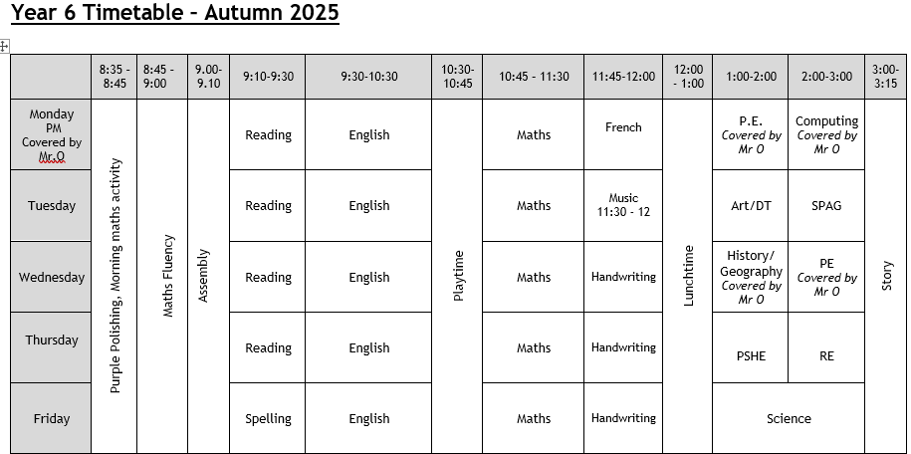
tIMETABLE

Slide 5
Uniform
Please ensure everything has your child’s name on it even if it is a preloved item.
Blue school jumper only, no other jumpers or hoodies.
Long hair must be tied up.
No jewellery – stud earrings are fine.
No nail varnish please.
No (re)dying of hair.

Slide 6
p.e
PE
  Trainers
  Blue PE t-shirt and jumper (in the cold)
  Dark (preferable black) shorts or tracksuit bottoms (in the cold)
  This term our PE days are Monday and Wednesday.
  Autumn 1: Cricket and Basketball

Slide 7

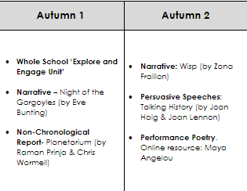
Curriculum MAP

Slide 8

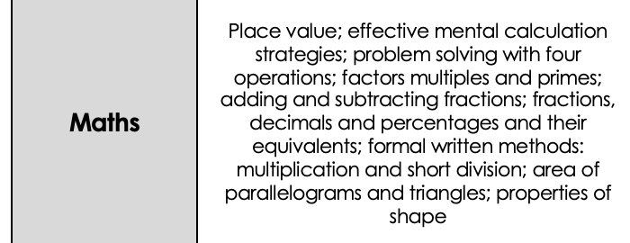
Curriculum MAP

Slide 9


Curriculum MAP

Slide 10



Curriculum MAP
Computing systems and networks: Communication and collaboration
Creating media: web page creation
Come dine with me
What does the census tell us about our local area?
Why does population change?

Slide 11


Curriculum MAP
Drawing: Make my voice heard
A l’ecole
Le week-end
What is the best way for a Muslim to show commitment to God?
Do Christmas celebrations and traditions help Christians understand who Jesus was and why he was born?
Being me in my world
Celebrating Difference

Slide 12

Home learning
Home support and education is so important, this year we will be setting homework due the following week.
Daily reading is expected.
Home Learning will be set on Friday and is due in on the following Wednesday.
Spellings
Maths
English

Slide 13
BEHAVIOUR
At Westfield we acknowledge that positive experiences create positive feelings, and that in turn, positive feelings create positive behaviour. Staff will model positive relationships and interactions, use positive phrasing with the children and spend time with children to support them in making positive behaviour choices – that result in pro-social behaviour - where required.
Pro-social behaviours are any actions which benefit the individual and others around them.
• Giving meaningful and specific verbal praise and positive feedback
• Allocating roles and responsibilities
• Communicating a child’s pro-social behaviours with parents and/carers as appropriate
• Using stickers, certificates, merits, value of the week, marbles etc
• Building in ‘motivators’ following the engagement of ‘adult directed activities’
• Awarding Teacher and Head Teacher awards
• Acknowledging pupils in Friday Celebration assembly
• Recognising care and respect of the learning environment
• Modelling and teaching children to self-regulate using resources that help pupils to stay calm and to understand their own emotions

Slide 14
BEHAVIOUR
Class rewards – each class has its own reward system for whole class rewards
Merits are received for positive work. Headteachers certificates are then received on receipt of 10 merits
Values certificates are given out each week to a child in each class who has demonstrated the value that week
Please share any outside achievements with us, we love to hear about them and celebrate what the children have achieved.
Celebration assembly on Fridays at 9am – all parents are welcome

Slide 15
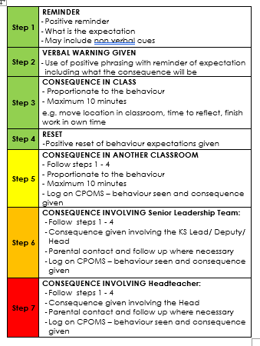

BEHAVIOUR
The Behaviour policy was re-written in January. Please ensure you have read it and are clear on our procedures within school. This includes our behaviour steps and level letters.

Slide 16
Mobile phones
We are supporting the ‘Smartphone free childhood’ campaign. As such we actively encourage you not to purchase a smart phone for your child.
As a town the schools are working together to have a collective approach on this moving forward.
Please read more about it at https://smartphonefreechildhood.co.uk/
Mobile phones are allowed in Y5 and Y6. They are to be handed in as soon as they enter school and will be returned at the end of the day
If your child does have a mobile phone, please carefully monitor their interaction on it. The social media issues which occur happen at home continue into school and significantly impact mental health and learning. We need to work together to support our children.

Slide 17
Helping in school
Parent volunteers are very welcome in school, either regularly or ad-hoc. A DBS check is required – forms from the office.
Reading with children – we really appreciate this in KS2.
WISPA are always wanting and needing parental engagement – please get involved! The funds they raise help to provide a range of wider opportunities for your children as well as resources in school.

Slide 18
Reminders
Most children benefit from having a piece of fruit at break time
No sweets in lunchboxes
Please let us know if pick up arrangements change
Let the office know of any regular pick up changes
Encourage your children to talk to the adults in school – we cannot help if we do not know. Any problems that arise are better dealt with there and then rather than at a later time
Stationery is provided so please leave all personal items at home
A named water bottle is needed in school daily

Slide 19
Communication
Everything we do is because we believe it will benefit the children. If you think there is something we should know that will help us help your child, please do tell us!
Please catch us at the start or the end of the day for any quick messages. For any longer discussions, please arrange a meeting.

Slide 20


Communication
Dates
Wednesday 4th february
-Wembley Arena

Slide 21

Communication
Dates
Monday 16th march – Friday 20th march
Year 6 Residential – PGL
Osmington Bay

Slide 22

Communication
Dates
Monday 11th May – Thursday 14th May
- Reading Comprehension
- Spelling and Grammar
- Maths Arithmetic
- Maths Reasoning x2 papers
Writing – teacher assessment
Science – teacher assessment

Slide 23


