Slide 1

Welcome to
EYFS

Slide 2
Meet the team
Class Teacher
Miss Taylor
Teaching assistants
Mrs Su
Mrs Bray
Mrs Waheed
Notes:
Hello, my name is Miss Taylor. I have been a teacher for 14 years and have taught different year groups. I'm really excited to be teaching your children, we've spent some time this week getting to know each other and this will continue next week (and over the year!)
This is Miss.... who the children already know.

Slide 3
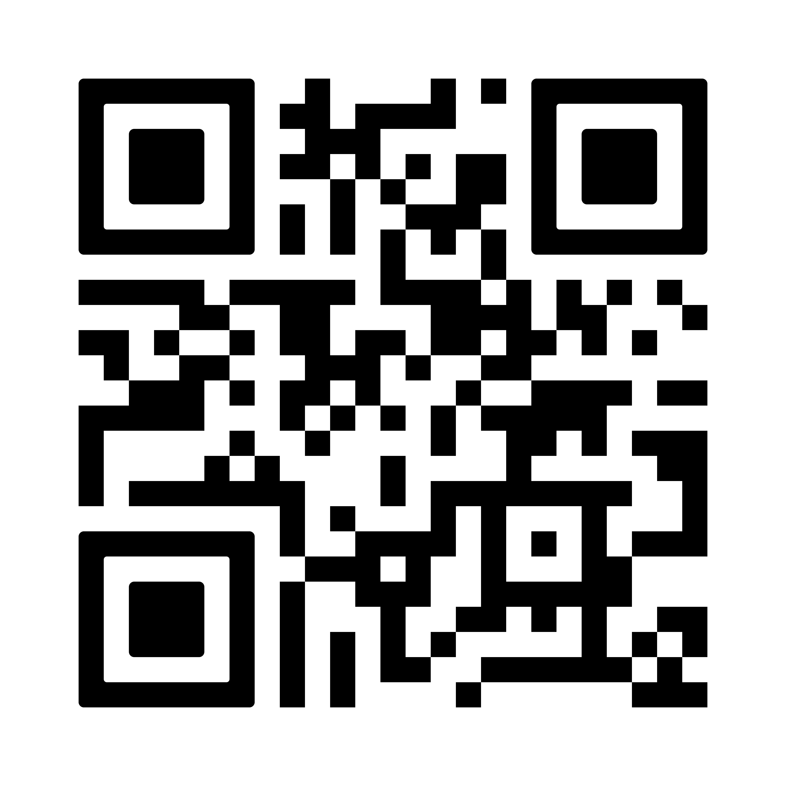
Seesaw
This year we would like to use Seesaw as an additional method of communication with parents.
We will add photos and short videos of your child for you to see the exciting things we get up to.
In order to do this, we need your permission. Please use the QR code to give your permission.

Slide 4
Start and end of the day
Soft start from 8:35-8:45am
Registers are at 8:45am. Anyone arriving after this time will be marked as late
Drop children at the outside door – Please allow them to walk in alone.
Collection at 3:oopm for Nursery and 3:10 for Reception
Please collect from the outside door.

Slide 5
Lunch
Nursery
Either a packed lunch or a purchased dinner (this costs £2.53)
Reception
We provide free school meals (as all schools do).

Slide 6
Uniform
Please ensure everything has a name on it.
Blue school jumper
White polo shirt
Grey trousers or skirt
White or grey socks
Long hair must be tied up
No jewellery – stud earrings are fine.
No nail varnish please
No (re)dying of hair

Slide 7
p.e
PE – Tuesday and Friday afternoons
  Trainers (worn all day) and change of socks
  Blue PE t-shirt and jumper (in the cold)
  Dark (preferable black) short or tracksuit bottoms (in the cold)
  PE kit can be worn all day by all children in EYFS even if they are not staying (however, you can choose to send them in normal uniform if they are not staying)

Slide 8
Forest School
Forest school – every Wednesday morning
Come to school in Forest School clothes- long trousers, and preferably long sleeves
Wellington boots – that will live in school
Weather suitable clothing (layers- we can take them off when we come back) - think about how you would feel if you were out in the freezing cold in thin socks, thin trousers and no hat or gloves
We will go out to Forest School regardless of weather – hot or cold, rain or sun!

Slide 9
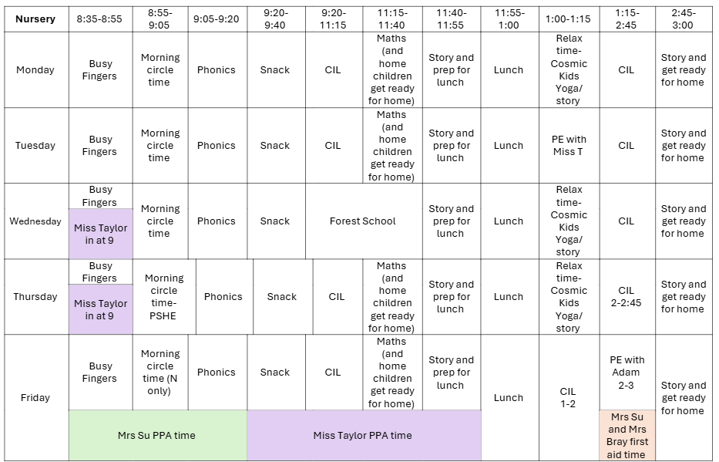
tIMETABLE
Add in a screenshot of your autumn timetable
Notes:
This is our timetable for the year. I have also printed this out and it is in the children's reading record books – I think it's nice for children to know what's coming up. Any anticipated changes I will always tell the children in advance.
Tuesday mornings Mr Trogden will be teaching the children with Miss Hall as a support.

Slide 10
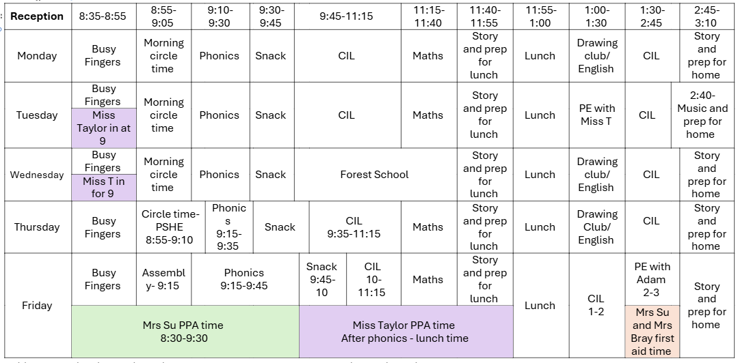
tIMETABLE
Add in a screenshot of your autumn timetable
Notes:
This is our timetable for the year. I have also printed this out and it is in the children's reading record books – I think it's nice for children to know what's coming up. Any anticipated changes I will always tell the children in advance.
Tuesday mornings Mr Trogden will be teaching the children with Miss Hall as a support.

Slide 11
English – Drawing club (rec)
Drawing Club is a true adventure. Based around the Golden Blend of picture books, tales and animations, it involves a short period of Time Together as a whole class followed by time with children exploring their ideas and creativity that can be adapted to how you believe is best.

Slide 12
Phonics
We will be starting Phonics soon
In Nursery this will focus on 7 strands - 1) Environmental sounds, 2) Instrumental sounds, 3) Body percussion, 4) Rhythm and rhyme, 5) Alliteration, 6) Voice sounds, and 7) Oral blending and segmenting
In Reception we will start by focussing on oral blending and segmenting before starting to learn some sounds.

Slide 13

Phonics Play
Buried Treasure (phonicsplay.co.uk)

Slide 14
Maths
Positional Language
Numbers to 10
Finding patterns, counting and comparing
Part whole addition and subtraction

Slide 15

Home learning
Please read with your child every day in Reception.
We have no other home learning in EYFS.

Slide 16
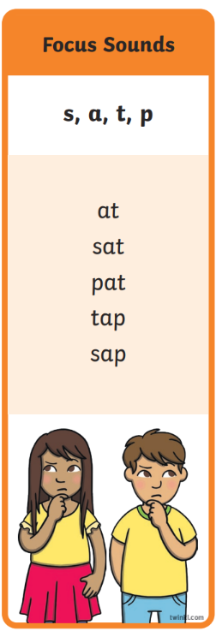
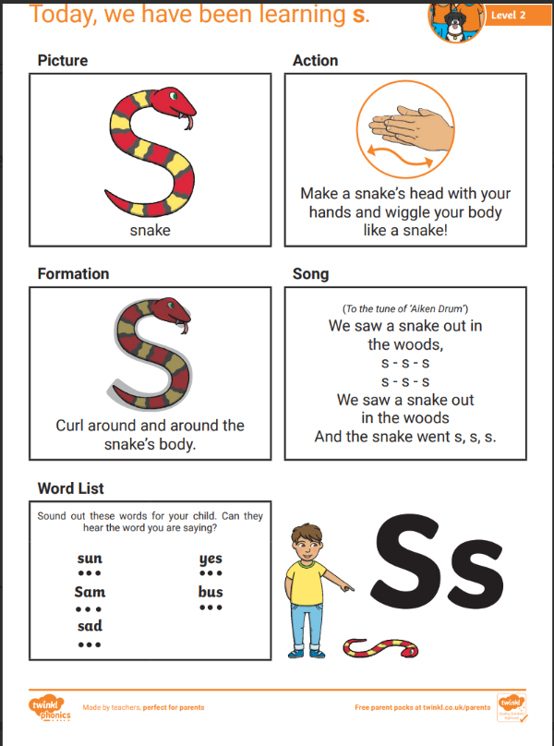
Phonics (ReceptioN)

Slide 17
BEHAVIOUR
At Westfield we acknowledge that positive experiences create positive feelings, and that in turn, positive feelings create positive behaviour. Staff will model positive relationships and interactions, use positive phrasing with the children and spend time with children to support them in making positive behaviour choices – that result in pro-social behaviour - where required.
Pro-social behaviours are any actions which benefit the individual and others around them.
• Giving meaningful and specific verbal praise and positive feedback
• Allocating roles and responsibilities
• Communicating a child’s pro-social behaviours with parents and/carers as appropriate
• Using stickers, certificates, merits, value of the week, marbles etc/
• Building in ‘motivators’ following the engagement of ‘adult directed activities’
• Awarding Teacher and Head Teacher stickers/awards
• Acknowledging pupils in Friday Celebration assembly
• Recognising care and respect of the learning environment
• Modelling and teaching children to self-regulate using resources that help pupils to stay calm and to understand their own emotions

Slide 18
BEHAVIOUR
Class rewards
Reward jar (when full they will earn a treat)
Reading certificates are received for reading 50, 100, 150 and 20o times
Please share any outside achievements with us, we love to hear about them and celebrate what the children have achieved.
Celebration assembly on Fridays at 9am – all parents are welcome.

Slide 19
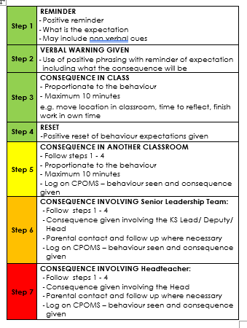
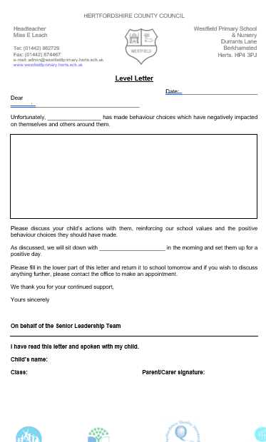
BEHAVIOUR
The Behaviour policy was re-written in January. Please ensure you have read it and are clear on our procedures within school. This includes our behaviour steps and level letters.

Slide 20
Mobile phones
We are supporting the ‘Smartphone free childhood’ campaign. As such we actively encourage you not to purchase a smart phone for your child.
As a town the schools are working together to have a collective approach on this moving forward.
Please read more about it at https://smartphonefreechildhood.co.uk/
Mobile phones are allowed in Y5 and Y6. They are to be handed in as soon as they enter school and will be returned at the end of the day
If your child does have a mobile phone, please carefully monitor their interaction on it. The social media issues which occur happen at home continue into school and significantly impact mental health and learning. We need to work together to support our children.

Slide 21
Helping in school
Parent volunteers are very welcome in school, either regularly or ad-hoc. A DBS check is required – forms from the office.
Reading with children – we really appreciate.
WISPA are always wanting and needing parental engagement – please get involved! The funds they raise help to provide a range of wider opportunities for your children as well as resources in school

Slide 22
Reminders
Children are provided with a piece of fruit for snack. Milk is free for all Nursery children and can be ordered for children in Reception.
No sweets, chocolate or nuts in lunchboxes
Please let us know if pick up arrangements change
Let the office know of any regular pick up changes
Encourage your children to talk to the adults in school – we cannot help if we do not know. Any problems that arise are better dealt with there and then rather than at a later time
Stationery is provided so please leave all personal items at home
Named water bottle

Slide 23
Communication
Everything we do is because we believe it will benefit the children. If you think there is something we should know that will help us help your child, please do tell us!
Please catch us at the start or the end of the day for any quick messages. For any longer discussions, please arrange a meeting.

Slide 24
Communication
The number one priority for our EYFS team is that your child is happy and settled and has an enjoyable year.
If you have any questions or concerns about your child’s education or well-being, then please communicate your worries with us.
We are always keen to help!

Slide 25


