Slide 1

The Smartphone Free Superpower
LUKE ROBERTS
Assistant Headteacher
Ashlyns School

Slide 2
Ashlyns School Phone Journey
Previously
‘Never Seen, Never Heard’
Currently
Prohibited Item
Lockable Phone Pouch
Sept 2026
(New Year 7’s)
‘No Smartphones’
Lockable Pouch

Slide 3
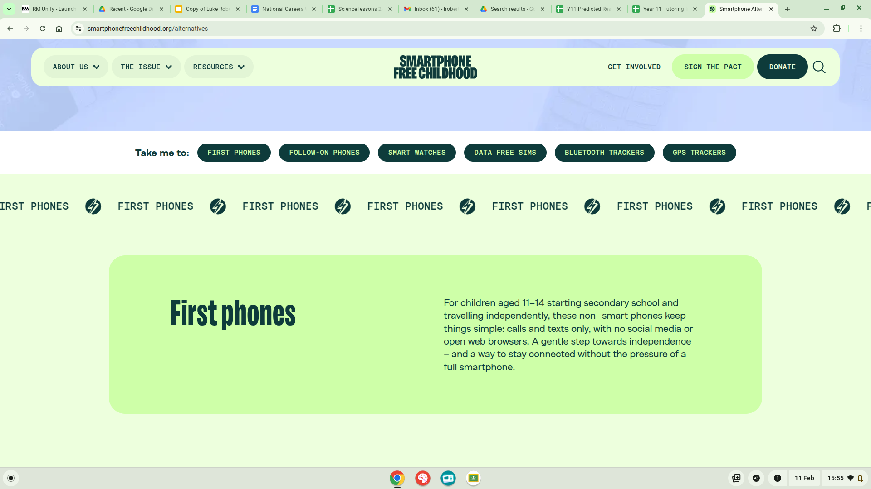
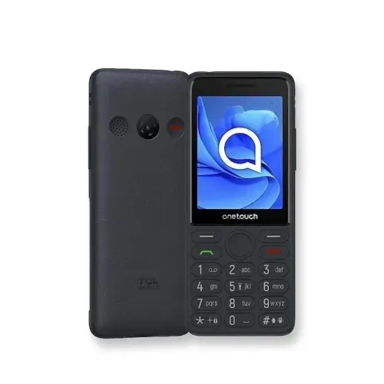

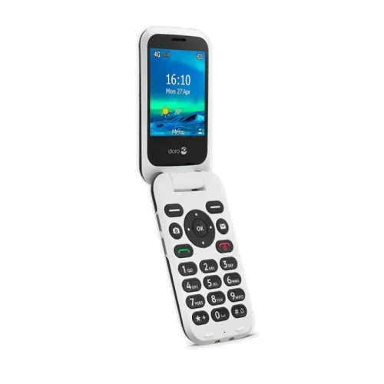
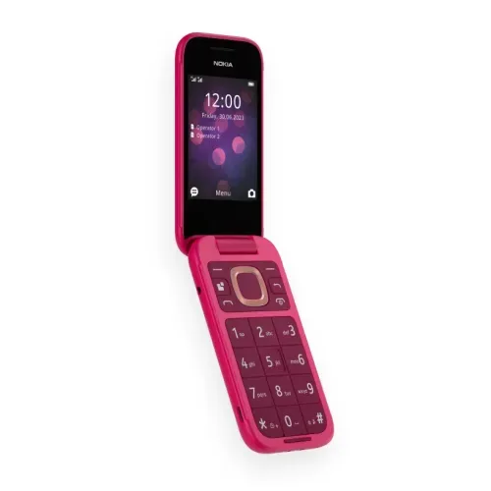

Nokia 105 2g
TCL 4022S
Doro 6820
Nokia Flip
Karri

Slide 4
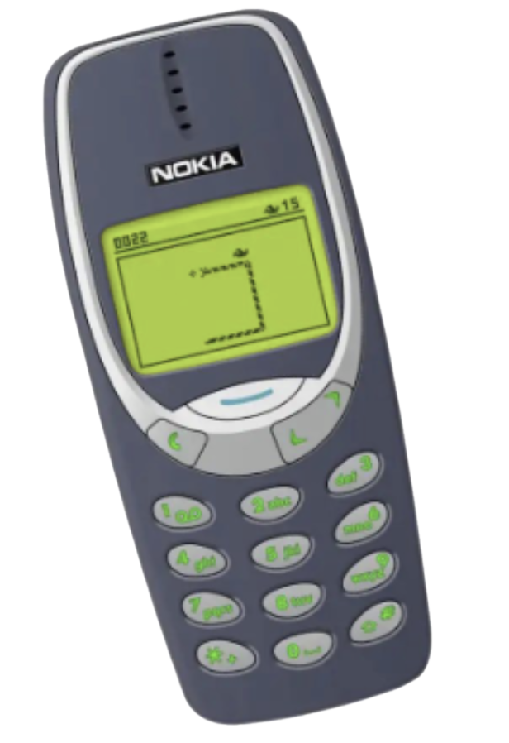
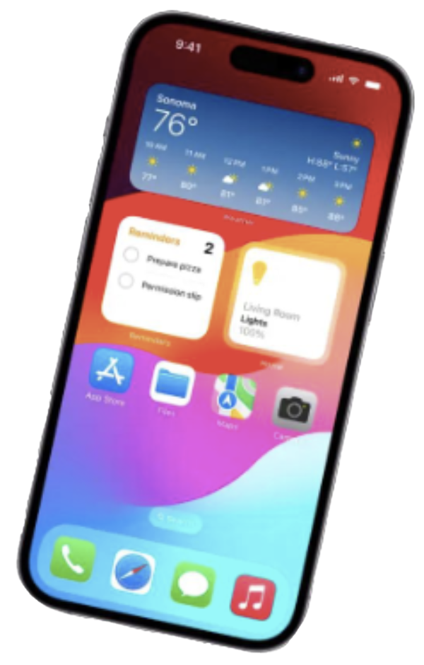
THEY’RE NOT REALLY ‘PHONES’ AT ALL
MOBILE PHONE
POCKET SUPERCOMPUTER
Make calls, send texts, play Snake
24/7 access to the internet in your pocket
Notes:
We call them ‘phones’, but it’s a pretty misleading name. It would be more accurate to call them handheld supercomputers – that put the whole of the internet and social media in your pocket 24/7. It’s important to point out that they don’t just give our children access to the internet – they give the whole of the internet access to our children.

Slide 5
Screen Time
The average amount
of time a teenager spends
online in the UK
34.3hrs
per week
75 days
a year
14.3
years in a lifetime
4.54hrs

Slide 6

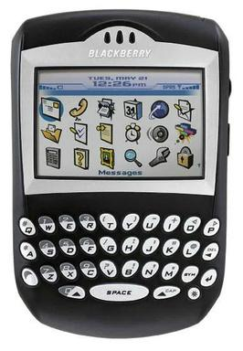





Timeline
EARLY 2000'S
2007-2008
2009-2010
2010-2014
2015-2025
Early ‘Smartphones’
& social giants begin
The iPhone ‘touch screen’
Tech behaviourists maximise engagement
Internet everywhere - 4G
97% of UK 12yr olds own a smartphone
2024: Social Media revenue >$250B; TikTok hits 1.8B users in 8yrs
Facebook 2002
YouTube 2005
Appstore 2008;
1st Android 2008
The like button & retweet button, infinite scroll, push notifications, algorithms and front-facing cameras
Instagram
Snapchat

Slide 7
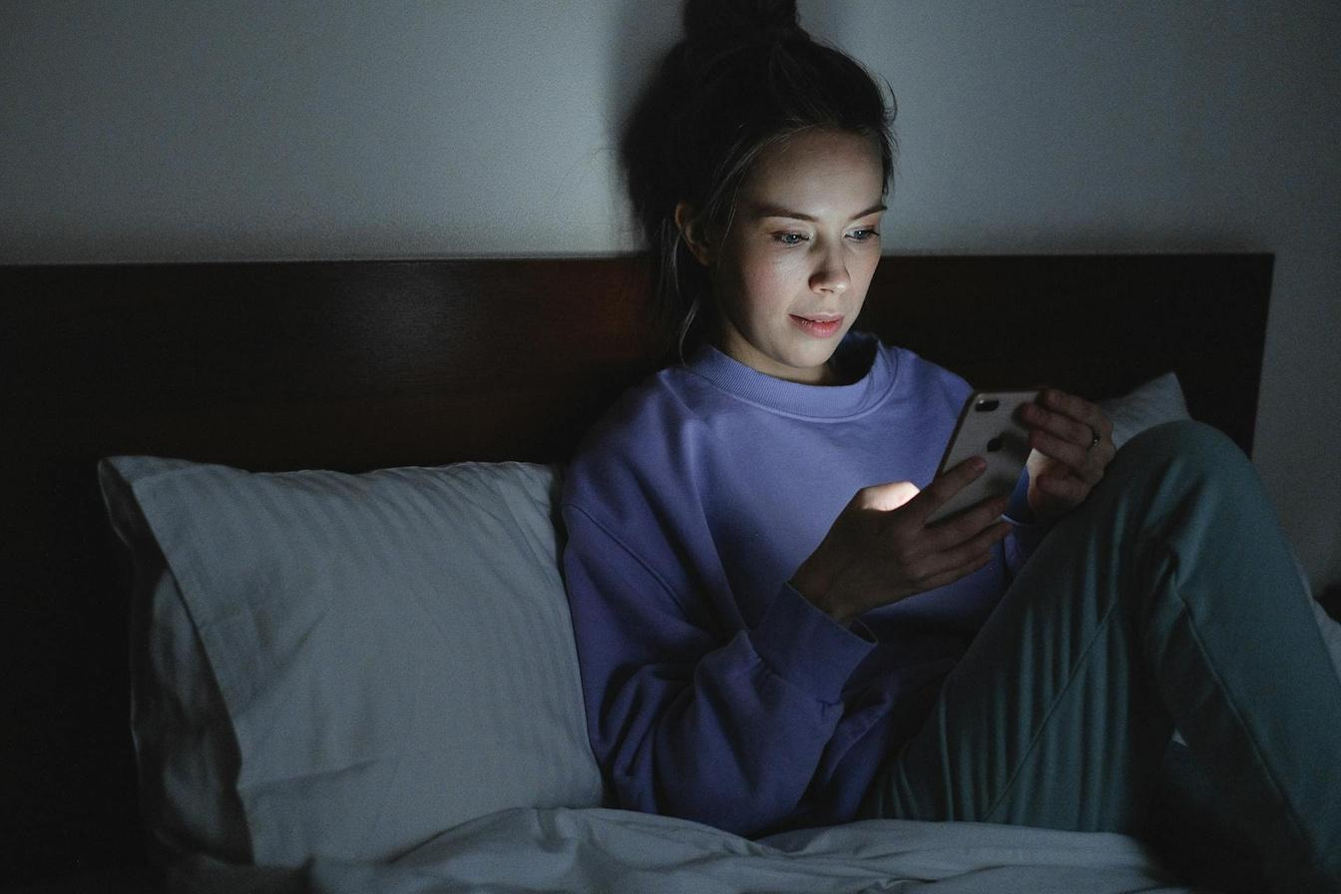

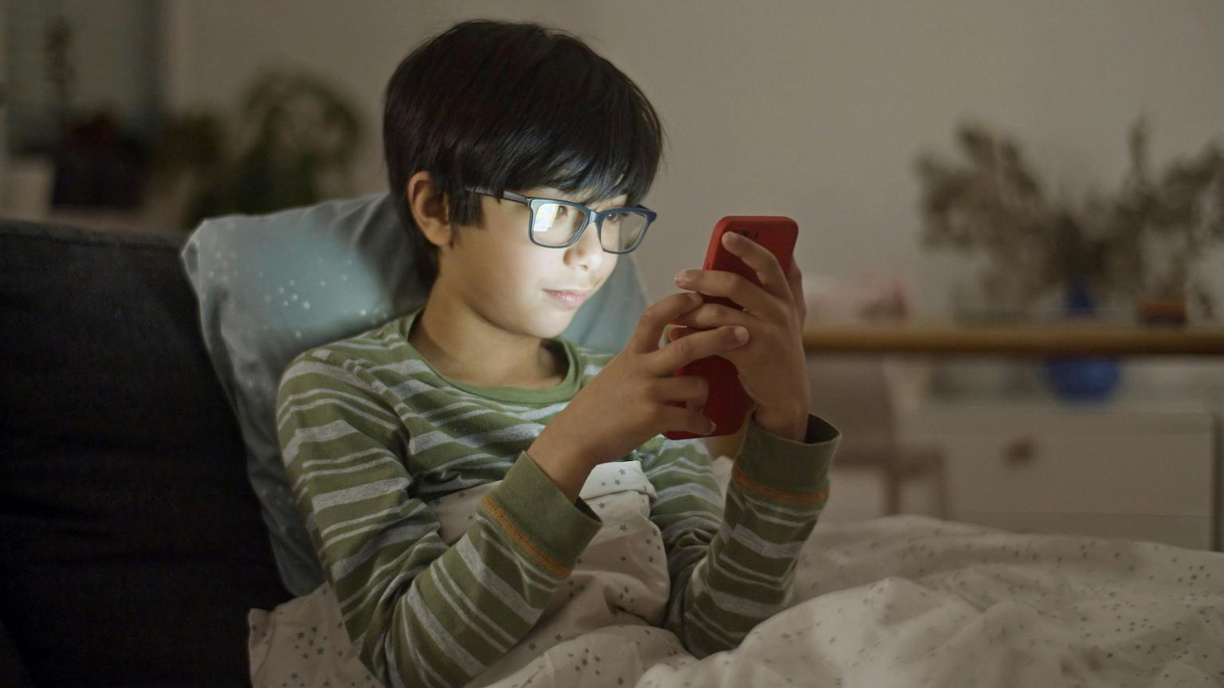
Persuasive Design
Smart technology taps into our dopamine reward pathway making us all vulnerable to overconsumption.
So powerful is persuasive tech that it has been described as akin to involuntary hypnotism.

Slide 8
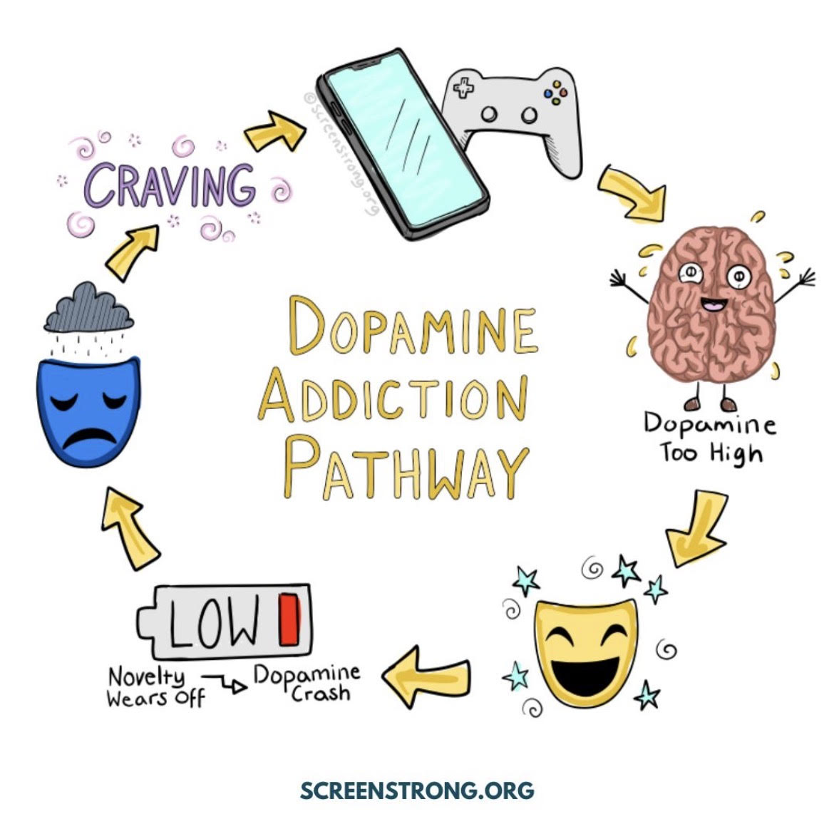
Persuasive Design
Dopamine is released during a reward which provides a learning signal to the brain.
The greater the ‘unexpected’ reward the greater the learning signal.
The motivational aspect of dopamine means that it can motivate us to do things that are good for us as well as those that are not.

Slide 9

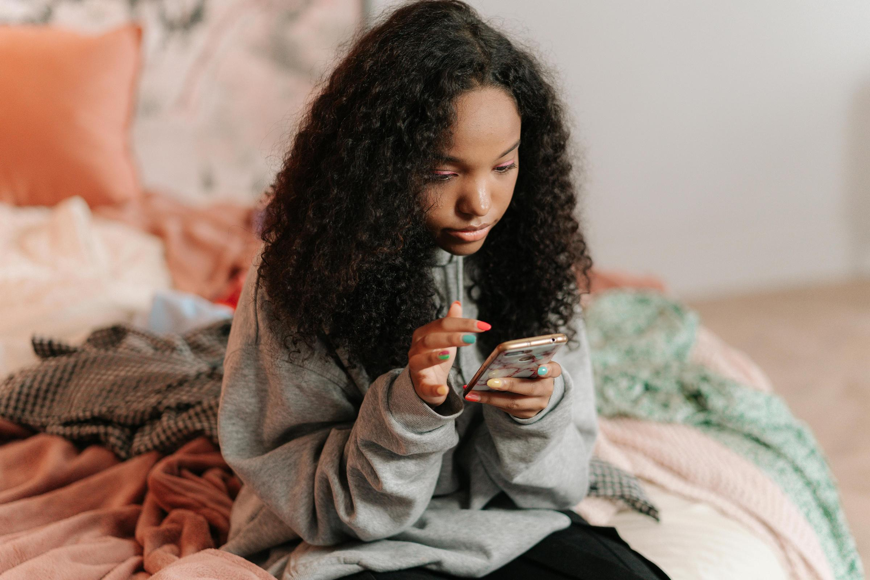
Children with Problematic Smartphone Usage (PSU) are twice as likely to experience anxiety and three times as likely to experience depression compared to children without PSU.
*King’s College London, 2024

Slide 10
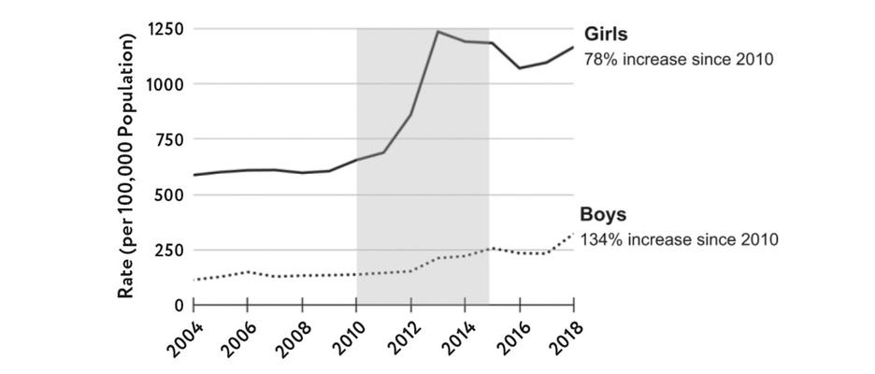
Mental
Health
According to NHS data in the past decade childhood outdoor accidents have reduced:
70%
but self-harm has increased:
93%
CYBULSKI ET AL, 2021
Figure from The Anxious Generation, Jonathan Haidt

Slide 11

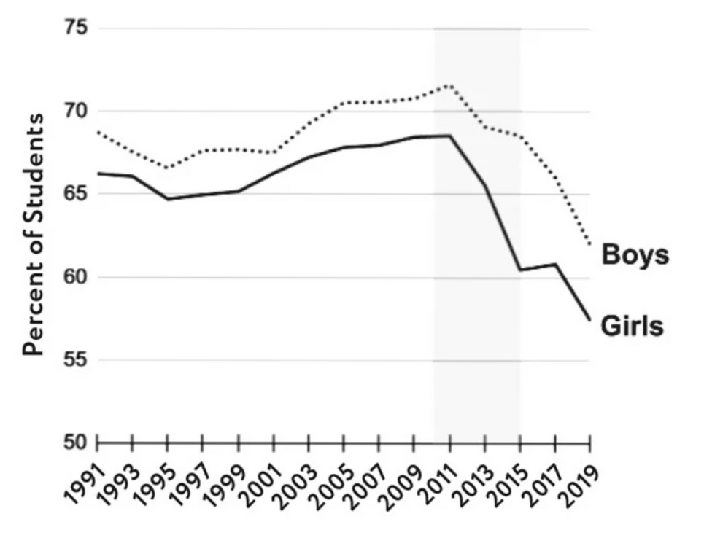

LET’S TALK ABOUT OUR KIDS AND THEIR TECH
Satisfied with Oneself
Comparison
“
Young people are comparing their real selves with other peoples’ curated images and highlight reels.
MONITORING THE FUTURE
Figure from The Anxious Generation, Jonathan Haidt

Slide 12

The TikTok Experiment
01.
Dummy accounts set up for 13-year-old girls
02.
Content about suicide shown within 3 minutes
03.
Content about eating disorder content shown within 8 minutes
04.
TikTok's algorithm delivered content promoting self-harm and eating disorders every 39 seconds to vulnerable users

Slide 13

Loneliness
13-17
Year olds are the loneliest group in society.
1 in 5
Teens report feeling lonely, with significant negative impacts on health, education and well-being.
*W.H.O., From loneliness to social connection:
charting a path to healthier societies 2025

Slide 14


What are they seeing?
The average first exposure to porn is 12 whilst doing their homework.
94% of children are exposed to porn by 14.
Rothman, E. F. (2021). Pornography and public health. Oxford University Press
Middlesex University report for NSPCC and the children’s Commissioner

Slide 15

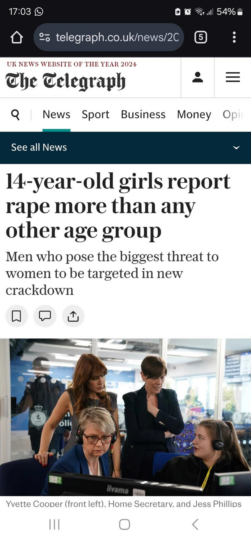

LET’S TALK ABOUT OUR KIDS AND THEIR TECH
The impact of Extreme Content?
“[The NCA] has seen a six-fold increase in reports of Child Online Abuse-related crimes in the last two years...We've seen thousands of users exchanging millions of messages around physical and sexual abuse online.”
James Babbage, Director General of Threats at the NCA, Sky News, 25 March 2025
Telegraph, 24 September 2024

Slide 16
The Children’s Commissioner Rachel de Souza spoke to a class of 15-year-olds:
What are they seeing?
75%
Had seen a beheading video

Slide 17
Of those bullied:
1 in 5 children
are bullied online
75%
were adversely affected
24%
*Online bullying in England and Wales - Office for National Statistics (ons.gov.uk), 2023.
*Ditch the label, The Wireless report , 2017
Self harm as a result

Slide 18
Pre-teens lose the equivalent of a nights sleep per week to social media
Sleep
73%
of teenagers take their phone to bed with them
*De Montford University, Leicester, 2022

Slide 19



The opportunity costs
*Oxford Home Schooling and Tuition, 2022
*The Raising the Nation Play Commission, 2025
x2
50%
Children spend twice as long looking at screens as playing outside
Children’s outdoor playtime has halved in a generation

Slide 20

Physical health
*BMJ, 2023
*British Journal of Ophthalmology 2024
1/3
30%
Almost a third of children who live in the most deprived areas of England have obesity by the time they leave primary school.
Childhood myopia has increased from 24% in 1990 to 36% in 2023. 30% higher risk of developing myopia from excessive screen time on smart devices.

Slide 21






SADLY, WE COULD GO ON
SLEEP
Bedtime use of smartphones doubles children's risk of poor sleep
BULLYING
84% of bullying now takes place on a device
DISTRACTIONS
On average teens are bombarded by 237 smartphone notifications a day
ARGUMENTS
55% of parents say their child’s smartphone use causes big family arguments
ROAD SAFETY
Mobile phone distraction is a major cause of road accidents involving children
CRIME
500 children a day were mugged in 2020 in the UK, almost all for smartphones
1: Jama Paediatrics, 2016; 2: Ofcom, 2022; 3: CommonSense Media, 2023; 4: HMD, 2024; 5: LookUp; 6: ONS, 2020
Notes:
There are so many other harms to mention, but if we look at them all in detail we could be here all day. Suffice to say that from sleep to bullying to road accidents, smartphones negatively impact children’s lives in a wide variety of ways.

Slide 22
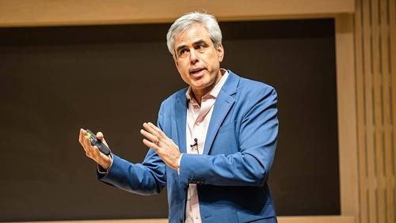
We have overprotected our children in the real world while under protecting them online
JONATHAN HAIDT

Slide 23




Slide 24
SOLUTIONS
What can we do?

Slide 25



Top tips
If you can, consider delaying the smartphone for as long as possible
If your child does have a phone, focus on healthy boundaries and staying safe online

Slide 26
Top Tips from a Cyber Security Expert
No exposure to social media.
No exposure to anonymous online chat.
No use of technology in private areas of the home - public areas only (no bedrooms & no bathrooms)
Before you give a smartphone you must educate about the safeguarding risks (sextortion, sexting, grooming)
No unsupervised use of youtube.

Slide 27
Delay the smartphone
Young adolescents
Or consider a smartphone without the internet or a basic phone.
“
Talk to other parents
Everyone else in my class has
a phone...
This is your superpower! Just because your child says everyone else has x doesn't mean they do.
Model good habits
Our relationship with our phones influences children’s view of healthy phone use.

Slide 28
Young adolescents
My elder son/ daughter already has a phone...
We know so much more about the harms now it’s ok to do thing differently
We live in a digital age, children need to be able to use technology...
Yes, but now we are aware of the harms we can take a precautionary approach and introduce later and with safeguards
But my child needs a smartphone for train tickets and bus tickets...
You can still buy tickets in person
I need a smartphone to track my child...
You can use an air tag (or similar) to track your child
Can’t we just use a stripped back iPhone with parental controls?
You can, but most parental control settings are easy to bypass

Slide 29


01.
Delay the first phone.
Consider a basic phone first.
Step wise progression
02.
14+ Consider a smartphone phone with strict controls.
03.
16+ A cautious trial of selected social media with private settings and time limits.
04.
Greater responsibility and freedom online.

Slide 30
AGE APPROPRIATE APPS
What is the age limit for social media apps?

Slide 31
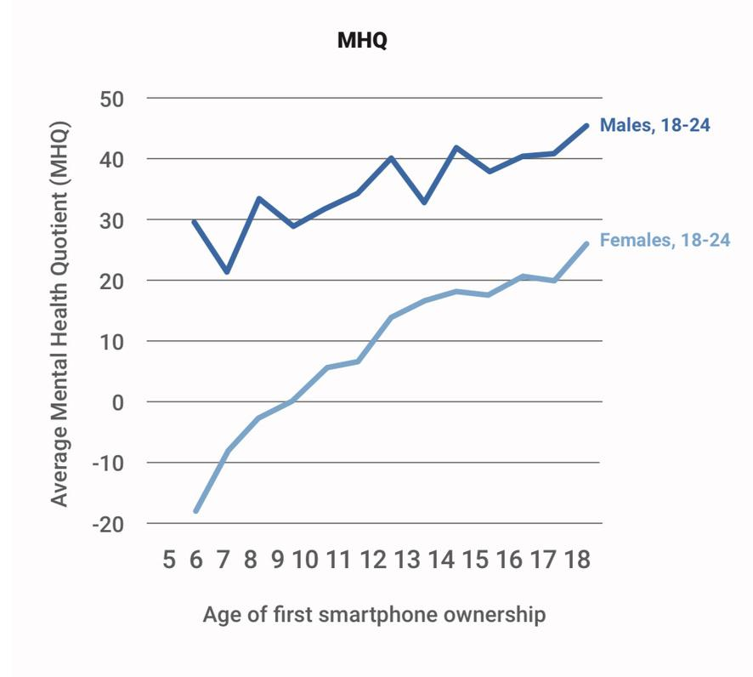
Mental health
Mental wellbeing improved with the older age of smartphone ownership.
The younger the age of first smartphone ownership the lower the mental health outcomes.
AGE OF FIRST SMARTPHONE/TABLET AND MENTAL WELLBEING OUTCOMES.
Sapien Labs, May 15, 2023

Slide 32
You can’t go back and change the beginning, but you can start where you are and change the ending.
C.S. LEWIS

Slide 33
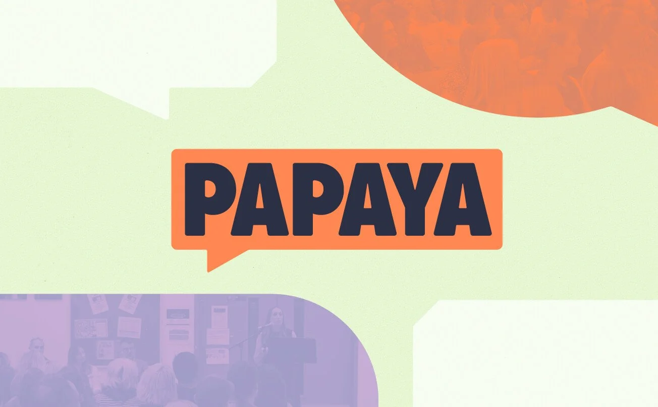

These slides have been produced in collaboration and with resources provided by Smartphone free childhood and PAPAYA Talks.
For more information about PAPAYA Talks please use the link:
For more information about Smartphone Free Childhood please click the link.

